Slide 1
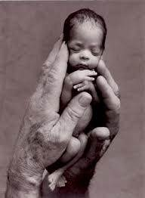
22 International Conference of A.P.P.A.C.
Post-Congress Workshop
« Psychoanalysis in Birth
Gain in Time Of Suffering »
19 May 2017
THE CENTER FOR SUPPORTING MOTHERHOOD
C.S.M.
mitrotita@yahoo.gr

